Slide 1

Measuring Development
4.8
Copyright Bananaomics

Slide 2

What do you believe to be the best tool to measure the level of development in a country?
Copyright Bananaomics

Slide 3

Multi-dimensional Nature of Economic Development
Copyright Bananaomics

Slide 4


Indicators
Development is a complex and intricate thing to measure. To classify countries economist use a variety of indicators.
Indicator
A measure of a certain characteristic
Single Indicator
The measure of a single characteristic of development
Composite Indicator
The measure of a multiple characteristics of development
Copyright Bananaomics

Slide 5
Indicators
Strengths of indicators to measure development
  Provides data over time to analyze progress and a point of comparison
  Data can determine which specific sectors of development are in urgent need.
  Data can guide government policy and determine the effectiveness of legislation.
Limitation of indicators to measure development
  Indicators presented as an average are flawed by hiding extreme conditions
  Gathering data is difficult financially and logistically.
  Informal economic activity is hidden. Poorer countries tend to have a large amount of informal economic activity.
  Cannot capture the complexity of development.
Copyright Bananaomics

Slide 6

Just How Multi-Dimensional is Development?
See how the rest of the world lives, organized by income | Anna Rosling Rönnlund
TED
Copyright Bananaomics

Slide 7

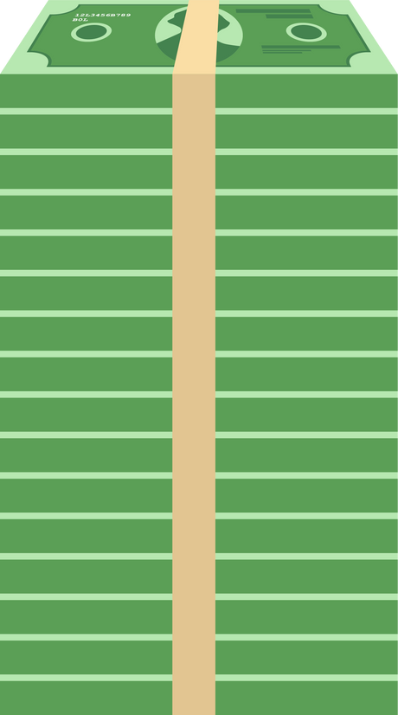
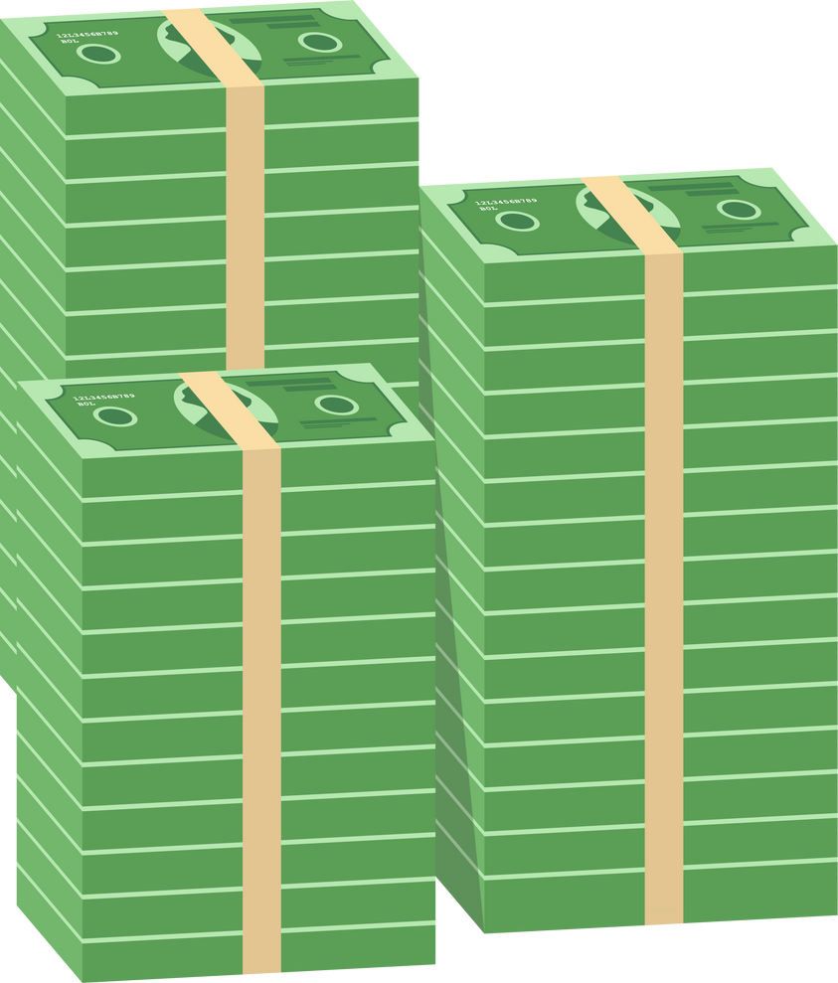


Dollar Street
Where do you think you fall on dollar street?
When you make your decision, select that range on Dollar Street and compare your house to the ones listed.
Copyright Bananaomics

Slide 8

Single and Composite Indicators
Copyright Bananaomics

Slide 9




Single Indicators
Single indicators use only one factor to measure the development of a country.
Examples of single indicators that aim to measure development
Income
    GDP/GNI per person (per capita) at PPP
    Absolute and relative poverty headcounts
  Health and education indicators
    Life expectancy at birth
    Infant mortality rate
    Average years of schooling
    Expected years of schooling (typically an age)
    Adult literacy rate
Copyright Bananaomics

Slide 10






Single Indicators
Single indicators use only one factor to measure the development of a country.
Examples of single indicators that aim to measure development
Economic/social inequality indicators
    Income equality (Gini coefficient)
    Access to resources by social group
    Gender ratio for average years of school
    Gender representation in government
Energy indicators
    Source of energy (hydropower, solar, wind vs coal, gas, etc.)
    Renewable energy
    Energy consumption per capita
Environmental indicators
    Carbon footprint
    Ecological footprint
Copyright Bananaomics

Slide 11

Composite Indicators
Because development is so complex to measure and no single indicator provides a holistic picture, it's often preferable to use a composite indicator.
Examples of composite indicators that measure poverty
Human Development Index (HDI)
    Used by the UN to determine the quality of life.
    3 main factors include:
      GDP Per Capita (Economic-Well Being)
      Life Expectancy (Healthcare)
      Average and Expected Years of Schooling (Education)
Gender Inequality Index (GII)
    Main factors:
      Reproductive Health (infant mortality, adolescent birth rate)
      Empowerment (government seats, gender ratio in education)
      Economic status (labor force participation gender ratio)
Copyright Bananaomics

Slide 12

Composite Indicators
Because development is so complex to measure and no single indicator provides a holistic picture, it's often preferable to use a composite indicator.
Examples of composite indicators that measure development
Inequality-adjusted Human Development Index (IHDI)
    Similar to HDI but takes into account inequalities for life span at birth, education, and income.
Happy Planet Index (HPI)
    Essentially divides HDI by the country's ecological footprint to determine its sustainability.
    Many developed countries score high in HDI but not HPI because they overuse resources. In contrast many countries in Asia and Latin America such as Costa Rica, score very high in HPI.
Copyright Bananaomics

Slide 13

Enjoying The Content?
Visit bananaomics.com to purchase package deals with discount prices!
BANANAOMICS

